Slide 1
Rotor Blade Design
Week: 03
Date: 14.10.2025
Supervisor: Prof. Dr. rer.nat. Alois Schaffarczyk
Presented by – Jay Pandya
Team members : Jay Pandya, Harsh Panchal, Kandarp Pathak, Daniyal Sikander

Slide 2
List of contents
Overview
Tip speed
Tip speed ratio (TSR)
Why it is important?
Thickness distribution
Jay Pandya Matriculation Number 770198

Slide 3
Overview
Rated power – 5 MW
Rotor Diameter - 160 m
Wind Speed - 9.3 m/s (as per management team)
Hub diameter – approx 3-4m (not decided yet)
Hub height - 120m
Rated Rotor Speed – 8.36-9.55 rpm (if rotor radius is 80m)
Blade length – 80-83m
Jay Pandya (770198)

Slide 4
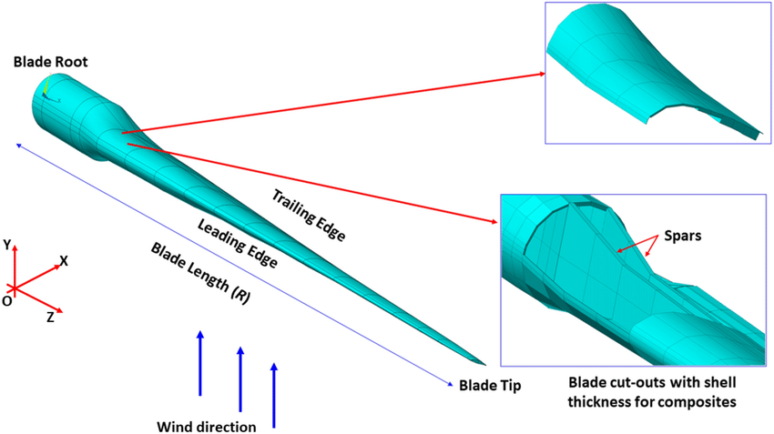
Tip Speed
Tip speed is the linear velocity of the blade tip as it rotates through the air.
Formula: Vₜ = ω × R
Where:
• Vₜ = Tip speed (m/s)
• ω = Angular velocity (rad/s)
• R = Rotor radius (m)
We have assumed 70-80 m/s.
Jay Pandya (770198)

Slide 5
Tip Speed Ratio (TSR)
Tip Speed Ratio (λ) is the ratio of the blade tip speed to the incoming wind speed.
Formula: λ = Vₜ / V_{w}
Where:
• λ = Tip speed ratio
• Vₜ = Tip speed (m/s) which we have assumed 80 m/s
• V_{w} = Wind speed (m/s) which is 9.3 m/s
TSR = 80/9.3
TSR ≈ 8.6
Jay Pandya (770198)

Slide 6
Why it is important?
High tip speed: Increases power but causes higher noise and stress on blades.
Low tip speed: Reduces noise but decreases efficiency.
Optimal TSR (6–10) ensures balance between efficiency, noise, and structural integrity.
Proper design helps maximize power coefficient (Cp).
Jay Pandya (770198)

Slide 7
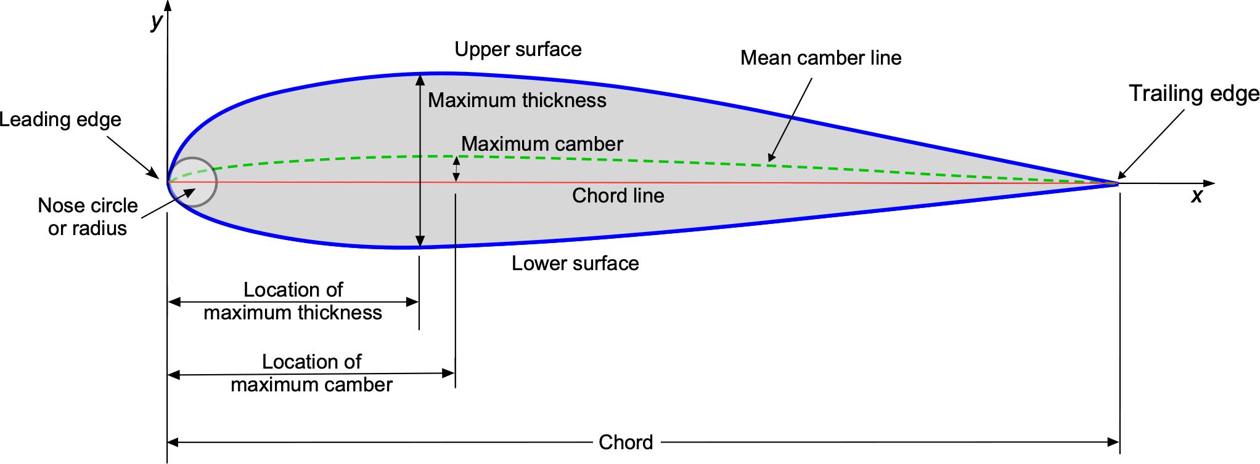
Thickness Distribution
Thickness distribution describes how the blade’s cross-sectional thickness changes from root to tip.
Balances aerodynamic performance and structural strength.
Root: 35–40% thickness – for structural strength.
Mid-section: 25–30% thickness – transition region.
Tip: 15–18% thickness – aerodynamic, reduces drag.
Jay Pandya (770198)

Slide 8
Next Week’s Work
To Determine exact numerical values for Tip Speed, Tip Speed Ratio, and Thickness Distribution for the 5 MW wind turbine.
Gather necessary aerodynamic and structural data for calculations.
We will discuss with the professor Schaffarczyk regarding next steps.
Jay Pandya (770198)

Slide 9
Bibliography
Burton, T., Jenkins, N., Sharpe, D., & Bossanyi, E. (2021). Wind Energy Handbook (3rd ed.). Wiley.
Hau, E. (2013). Wind Turbines: Fundamentals, Technologies, Application, Economics (3rd ed.). Springer.
Schaffarczyk, A. P. (2014). Understanding Wind Power Technology: Theory, Deployment, and Optimisation. Wiley.
DNV GL. (2016). Design and Analysis of Wind Turbine Blades – Guideline for Certification.
National Renewable Energy Laboratory (NREL). (2009). Wind Turbine Design Guideline DG03: Blade Structural Testing.
Global Wind Energy Council (GWEC). (2024). Global Wind Report 2024.
Jay Pandya (770198)

